Slide 1
Python Tutorial
By Alok kumar Nayak

Slide 2
Installation of Python
Install Python on Windows
First, download the latest version of Python from the download page.

Slide 3
Continued…
Second, double-click the installer file to launch the setup wizard.

Slide 4
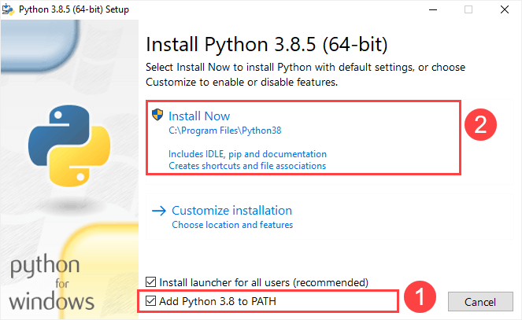
Continued..

Slide 5
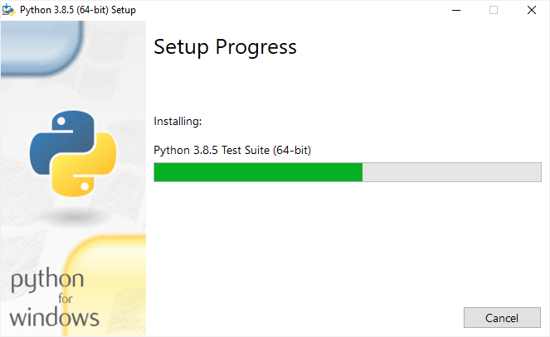
Continued..

Slide 6
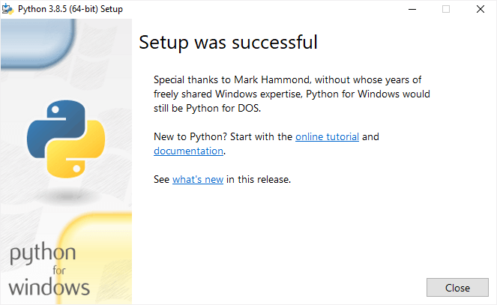
Continued..

Slide 7
Verify the installation
To verify the installation, you open the Run window and type cmd and press Enter:

Slide 8
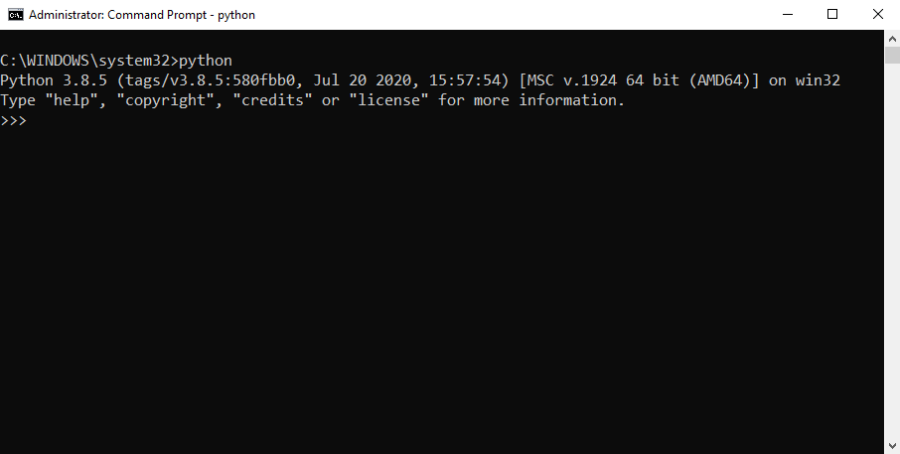
Continued..

Slide 9
Continued..
If you see the following output from the Command Prompt after typing the python command:
'python' is not recognized as an internal or external command, operable program or batch file.
Likely, you didn’t check the Add Python 3.8 to PATH checkbox when you install Python.

